Slide 1

NEUROMEND
An ICT313 Games Technology Project
By Tempest
  Ary Bizar, Anopan Kandiah, Hannah Klinac, Alex Mlodawski, Bryan Yu

Slide 2
Introduction
Project Name: Neuromend
Team Name: Tempest
Team Members:
  Ary Bizar
  Anopan Kandiah
  Hannah Klinac
  Alex Mlodawski
  Bryan Yu
Client: Shri Rai
Supervisor: Fairuz Shiratuddin

Slide 3
Project Management
Methodology
  SCRUM
    Several changes to the requirements occurred during the project’s lifecycle and adopting this methodology has helped meet deadlines in that respect.
Weekly team/supervisor meetings
  Discussed requirements
  Discussed issues
  Demonstrated prototypes
Source code control
  GitHub
    Separate folders for each device
    Folder for documentation

Slide 4
Background
Stroke
  Interrupted blood flow to the brain
  Lack of oxygen causes brain cells to die
  Motor, sensory, and cognitive problems
Rehabilitation
  Neurogenesis
  Rewiring

Slide 5
Problem
Rehabilitation
  Expensive
    Typically large scale equipment involved.
    Requires supervisors to have gone through extensive training.
  Tedious/boring
    Repetitive movements with no goals other than to get back motor control.
  Limited
    Depending on the type, rehab is mainly limited to what the already existent equipment are capable of.

Slide 6
Solution
Virtual Simulation
  3 worlds
Devices
  Oculus + Keyboard and mouse
  Oculus + Razer Hydra
  Oculus + Kinect
  Oculus + Leap Motion
Sensitivity/Settings
Monitoring progress
Profiles on a database

Slide 7
The World
Immersive environments
Consistency between levels
Interesting visuals
Tasks
  Simplistic
  Varied

Slide 8

Database

Slide 9
Razer Hydra (Bryan)

Slide 10
Kinect (Alex + Anopan)
Oculus Rift
  Player head tracking
Microsoft Kinect
  Gesture tracking involving player’s arms and hands.
  Tracking of gestures is done through the use of invisible collidable objects, which are located around the player and other objects to be interacted with.
  Entering a hand or both hands into such invisible object\s will trigger an appropriate action.

Slide 11
Kinect Object Interaction
Player remains in a stationary position.
Objective one
  Gestures
    Press
      Move a hand over to a button to press it.
Objective two
  Gestures
    Grab
      Move hands over to a cube, sphere or pyramid object to grab it.
    Drop
      Hover hand over a window in front of you to drop the held object through it.
Degree of hand/arm movement is dependent on the sensitivity setting.

Slide 12
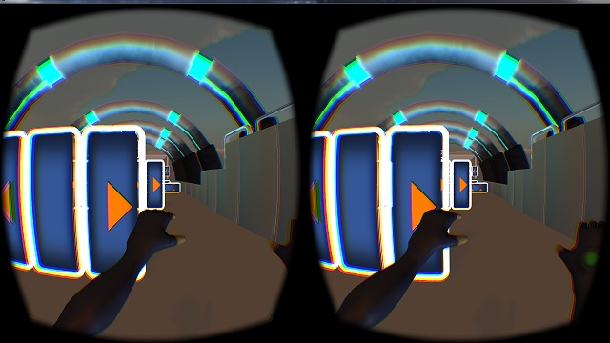
Kinect Object Avoidance
Moves player forward automatically at an adjustable speed.
4 gestures-
  Strafe left
    Use of left hand only
  Strafe right
    Use of right hand only
  Jump
    Use of both hands
  Crouch
    Use of both hands
Degree of hand/arm movement is dependent on the sensitivity setting.

Slide 13
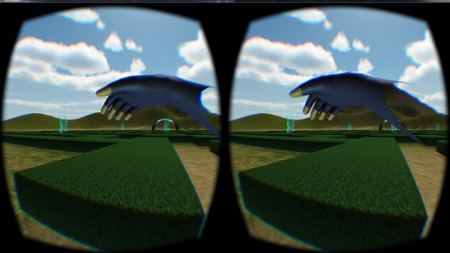
Kinect Way Finding
Player have full control of movement
4 gestures
  Move
    Hold both hands in
    front of you
  Stop
    Lower hands down
    to your sides
  Rotate left
    Shift left hand to
    the left
  Rotate right
    Shift right hand to
    the right
Degree of hand/arm movement dependent on sensitivity setting.

Slide 14
Leap Motion (Hannah)

Slide 15
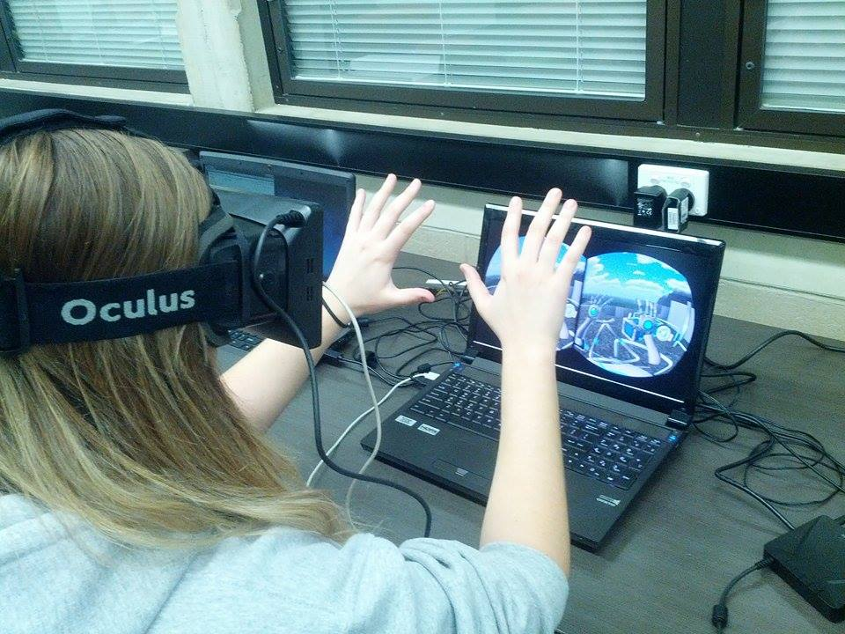
Leap Motion (Hannah)

Slide 16
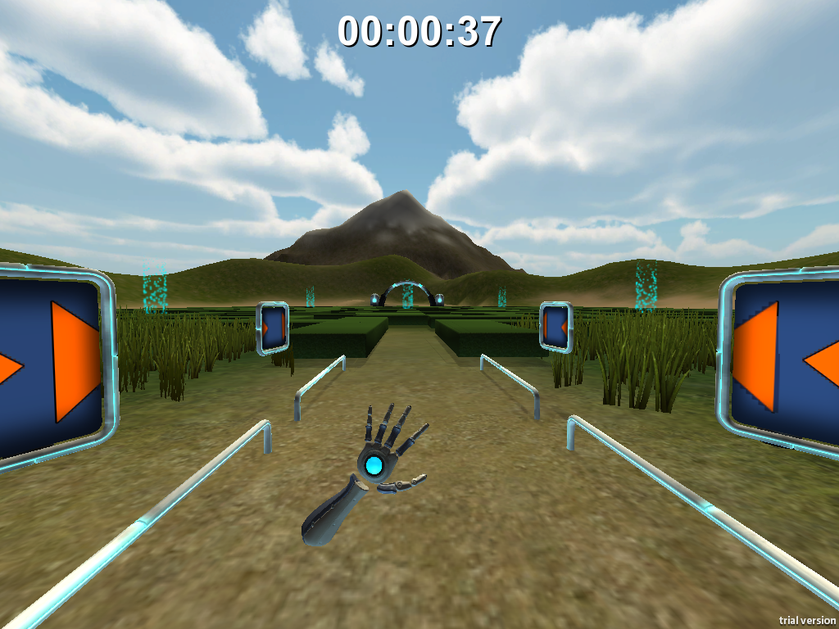
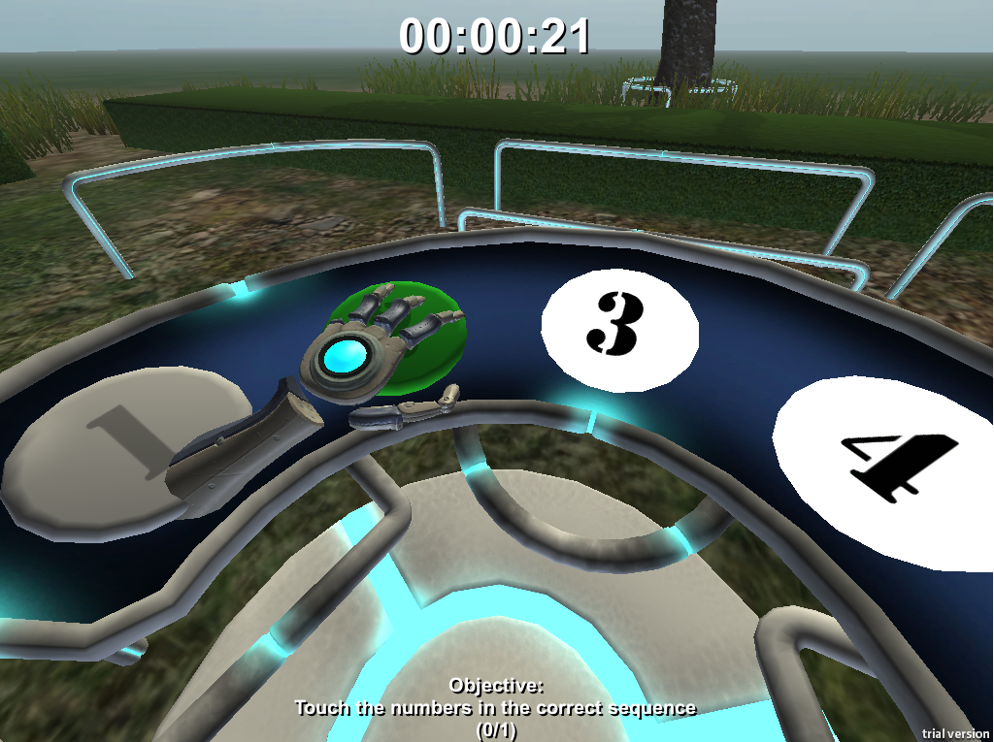
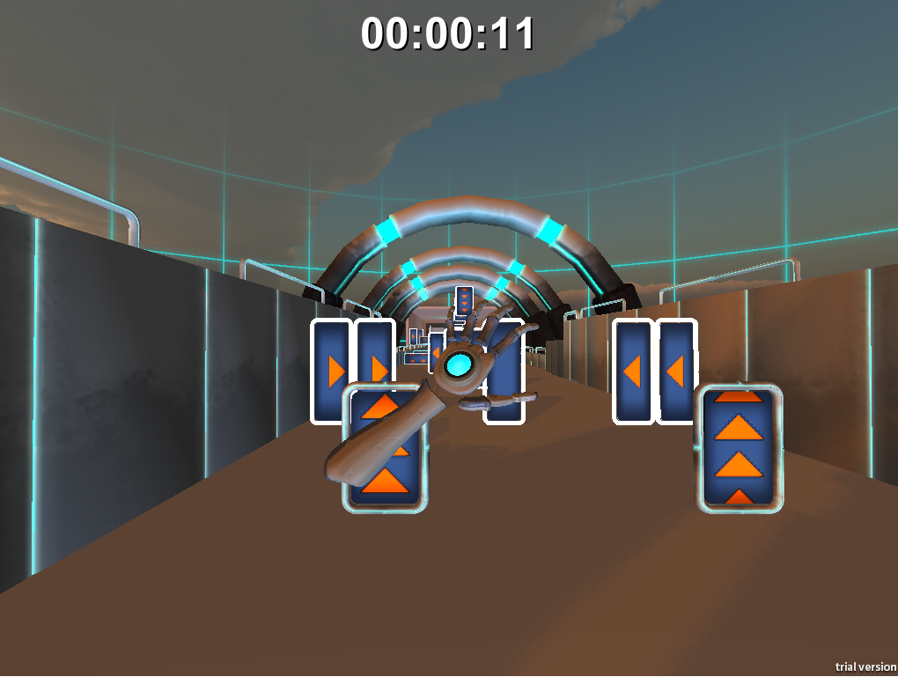
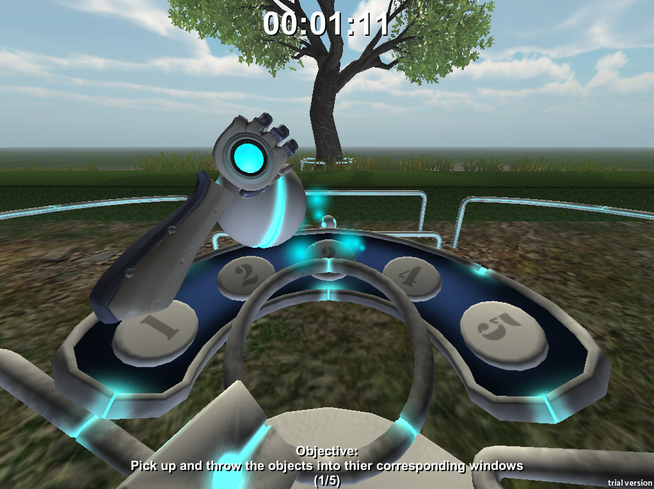
Leap Motion

Slide 17
Current Status
Virtual Simulation
3 levels
Devices
Database
Sensitivity/settings

Slide 18
Future Possibilities
Clinical use
Adding speech
Future devices

Slide 19
Challenges and Lessons Learned
Devices
  Beta products
  Driver clashes
  Versions/compatibility
Designing movements/gestures
Version control (levels + devices)
Communication

Slide 20
Acknowledgements
Client – Mr Shri Rai
Supervisor – Dr Fairuz Shiratuddin

Slide 21
Questions?

